Slide 1
Space Charge and Beam Beam Effects
Eric Prebys, FNAL

Slide 2
Space Charge
So far, we have not considered the effect that particles in a bunch might have on each other, or on particles in another bunch.
Consider the effect off space charge on the transverse distribution of the beam.
radial charge density
If we look at the field at a radius r, we have

Slide 3
Similarly, Ampere’s Law gives
Linear charge density

Slide 4
We can break this into components in x and y
Non-linear and coupled ➔ ouch! but for x<<σ_{x}
~linear and decoupled

Slide 5
“classical radius”
This looks like a distributed defocusing quad of strength
so the total tuneshift is
“Bunching factor”
Maximum tuneshift for particles near core of beam

Slide 6
Example: Fermilab Booster@Injection
This is pretty large, but because this is a rapid cycling machine, it is less sensitive to resonances
Because this affects individual particles, it’s referred to as an “incoherent tune shift”, which results in a tune spread. There is also a “coherent tune shift”, caused by images charges in the walls of the beam pipe and/or magnets, which affects the entire bunch more or less equally.
This is an important effect, but beyond the scope of this lecture.

Slide 7
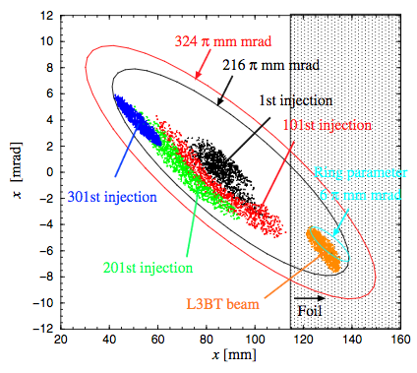
Space Charge Considerations
In general, space charge tuneshifts limit the total beam that can be injected into a machine. The tuneshift is and we would like to keep the magnitude below about .2
One technique is to “paint” the beam to fill the aperture and reduce the normalized emittance
Example: The J-PARC in Japan injects 400 MeV beam into their Rapid Cycling Synchrotron and “paints” it to uniformly populate 100 π-mm-mrad

Slide 8
Increasing Energy
Including different distributions:
So the maximum injected charge grows rapidly with increasing energy
“Bunch factor” = I_{peak}/I_{ave}
(Reduce with higher RF harmonics)
total protons
= . 5 for Gaussian emittance 3 for 95% Gaussian emittance
1 for 100% uniform (painted) emittance
normalized emittance
doesn’t include improvement of going to uniform distribution with painting

Slide 9
Beam-beam Interaction
If two oppositely charged bunches pass through each other…
Both E and B fields are attractive to the particles in the other bunch
If two bunches with the same sign pass through each other…
Both E and B fields are repulsive to the particles in the other bunch
In either case, the forces add

Slide 10
Integrate…
Effective Length
Front of first bunch encounters front of second bunch
Front of first bunch exits second bunch.
“Effective length”

Slide 11
Small x and y
Maximum tuneshift for particles near center of bunch
normalized emittance
“Tuneshift Parameter”

Slide 12
Luminosity and Tuneshift
The total tuneshift will ultimately limit the performance of any collider, by driving the beam onto an unstable resonance. Values of on the order ~.02 are typically the limit. However, we have seen the somewhat surprising result that the tuneshift
does not depend on β*, but only on
For a collider, we have
We assume we will run the collider at the “tuneshift limit”, in which case we can increase luminosity by
Making β* as small as possible
Increasing N_{b} and ε proportionally.

